Slide 1

Dynamics of microdroplets under oscillatory and quasi-static deformation
MASc Thesis Defense
Sanket Biswas
Supervisors: Dr. John M. Frostad, Dr. Gwynn J. Elfring
Department of Chemical and Biological Engineering The University of British Columbia, Vancouver, Canada 12 November 2025

Slide 2
Why microdroplets matter: targeted drug delivery
35M+ new cancer cases globally in 2050 (≈60% ↑ vs 2025)
Standard treatments → severe side effects
Alternative: targeted therapy with microdroplet drug carriers
Need: material properties of single microdroplets
Challenge: measuring properties of tiny, highly deformable droplets is difficult
Microdroplet-based drug delivery
Drug-loaded microdroplets
Yuan et al., Advanced Functional Materials (2024)
Liyanage et al., Biochimica et Biophysica Acta (2019)

Slide 3
Macroscopic vs microscopic squeezing: bulk vs interfacial stresses
small size, interfacial stresses important
Singh et al., Physics of Fluids (2025)
Oscillatory squeeze flow rheometer (OSFR)
Newtonian fluids:
Stefan (1875)
Viscoelastic fluids:
Phan-Thien (1980), Wingstrand et al. (2016)
Capillary number:
large size, bulk stresses dominate
Elasto-capillary number:
Bell et al., Rheologica Acta (2006)

Slide 4
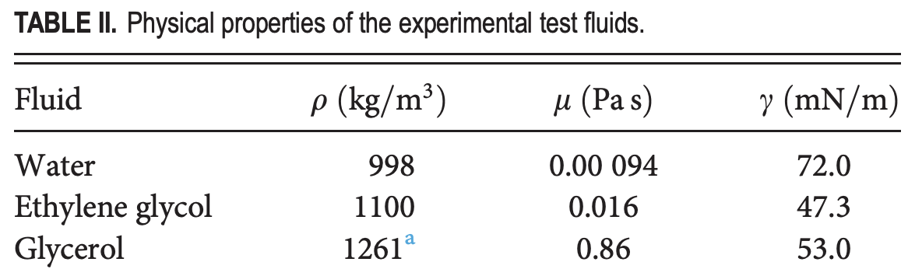
Squeezing of low-viscosity Newtonian droplets $\left(Ca \text{≲} 1\right)$
(Laplace pressure + line interfacial tension)
(curvature stresses)
(bulk viscous stresses)
Barakat et al., Physics of Fluids (2021)
(microdroplet regime)

Slide 5
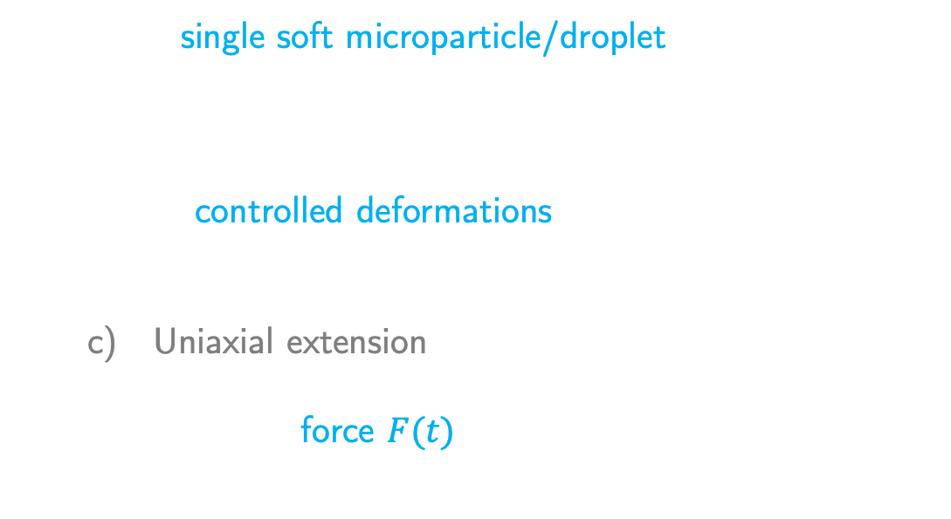
CCFA: squeezing single microdroplets to measure material properties
Cantilevered capillary force apparatus (CCFA)
Fixes a single soft microparticle/droplet (≈10 μm–1 mm) between its capillaries
Imposes controlled deformations:
Oscillatory
Quasi-static
Uniaxial extension
Measures the force $F(t)$ from the cantilevered capillary deflection
Frostad et al., Langmuir (2013)
Oscillatory squeezing of viscoelastic microdroplets: CCFA $→ F\left(t\right)→$ theory? $→\left\{G^{′}, G^{′′}, γ\right\}$

Slide 6
Quasi-static deformation: measuring interfacial tension
Linear model:
Kusumaatmaja and Lipowsky (2010)
Quadratic model:
?
Sariola (2019)

Slide 7


Objectives: develop analytical frameworks to link microdroplet force response to material properties
Quasi-static deformation (Newtonian)
Nonlinear force and shape of a Newtonian microdroplet, enabling extraction of $γ$
Validate against numerical solutions
Oscillatory deformation (viscoelastic)
Small-strain, thin-gap force response of a viscoelastic microdroplet
Procedure to extract $\{G^{′}, G^{′′}, γ\}$ from the measured force

Slide 8
Quasi-static deformation: governing equations
Force response:
Capillary separation:
Bridge volume conservation:

Slide 9
Regular perturbation in small displacement to avoid elliptic integrals
Small dimensionless displacement:
Force:
Mean curvature:
Pinning angle:

Slide 10
Present quadratic model captures nonlinear force for all radii

Slide 11
Analytical shapes match numerical profiles

Slide 12
Cubic error scaling (${∼ε}^{3}$)

Slide 13
Oscillatory deformation: governing equations
Maxwell (droplet):
Lubrication (droplet):
Thin gap:
Small-strain:
Stokes (ambient):
Initial pinning angle:

Slide 14

Oscillatory deformation: boundary conditions
No-slip on substrates
Axisymmetric (regular at $r=0$)
Quiescent far field
Kinematic condition at interface:
Thin gap:
Interfacial stress balance:
Small-strain:
Initial pinning angle:

Slide 15
Force decomposition and limiting-case validation
(Laplace pressure + line interfacial tension)
(curvature stresses)
Barakat et al. (2021)
(bulk viscous stresses)
Phan-Thien (1980), Wingstrand et al. (2016)
(bulk elastic stresses)

Slide 16
Material properties from force response
Static offset:
Amplitude:
Phase lag:

Slide 17
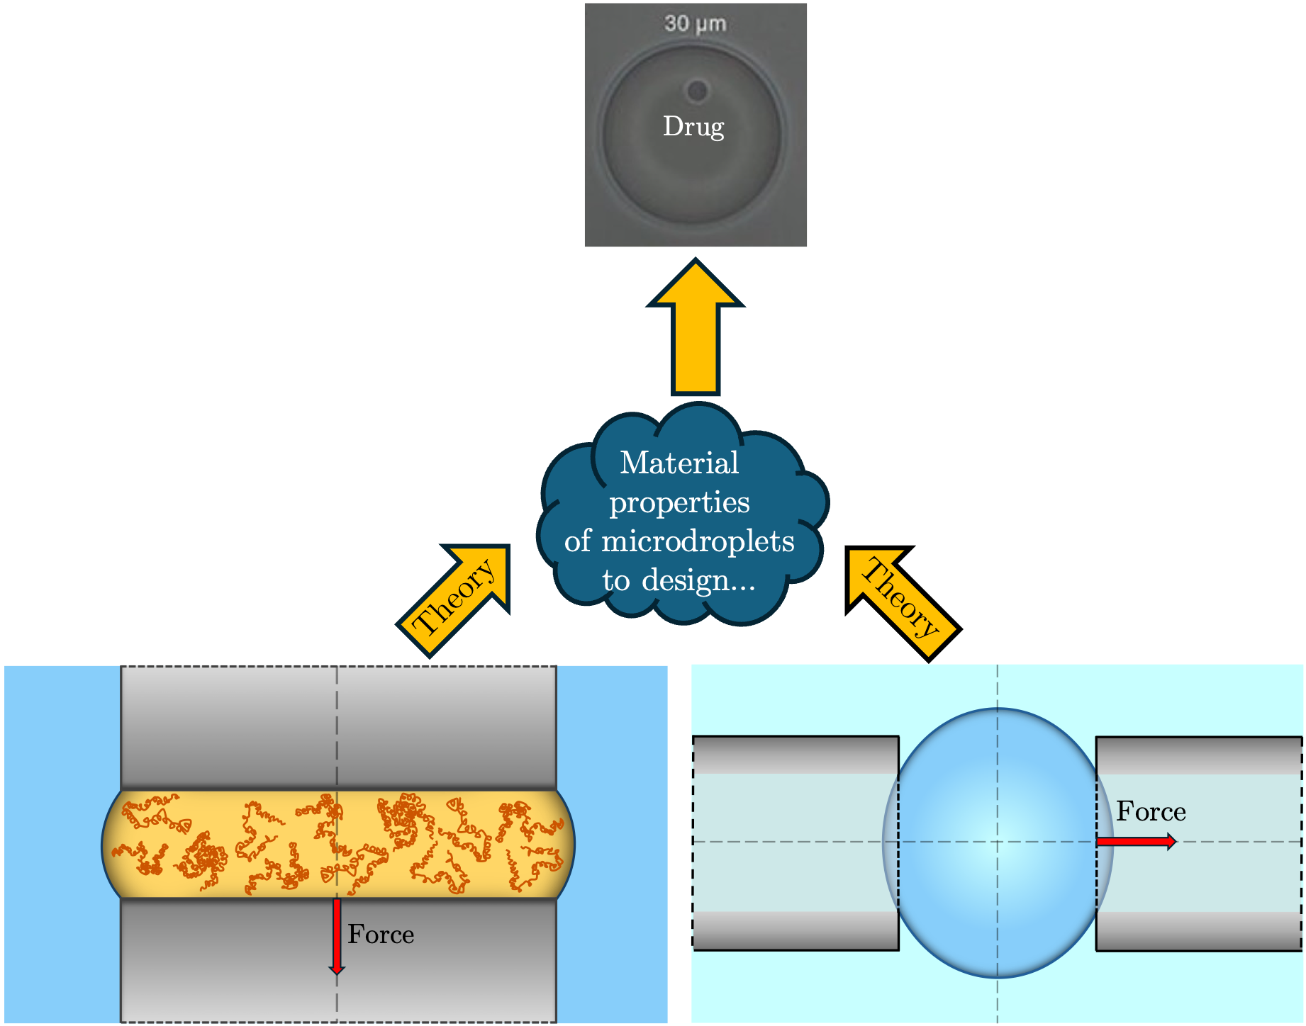
Key takeaways
Theory for nonlinear quasi-static force-shape of Newtonian microdroplets; infer interfacial tension
Theory for thin-gap, small-strain oscillatory force of viscoelastic microdroplets
Method to decouple interfacial tension and bulk rheology from measured force

Slide 18





Acknowledgements

Slide 19

Young-Laplace equation and parameterized bridge profile
Axisymmetric Young-Laplace equation:
In terms of tilt angle $φ$:
First integral:
Radial profile:
Axial profile:

Slide 20
First-order coefficients

Slide 21
Second-order coefficients

Slide 22
Coefficient comparison

Slide 23
Validity of the bridge volume conservation constraint

Slide 24
Numerical scheme to solve the Young-Laplace equation
Parameterized bridge profile in terms of $φ$ can be further parameterized in terms of the curvilinear arc length $s$, leading to the ODE system:
Finn (1986), Moran et al. (1999)
Origin $s=0$ placed at the left capillary rim plane.
ODE system solved for a given force $\hat{F}$ using the RK45 scheme, subject to the initial conditions:
unknown, a constraint is needed to fix it (shooting method)

Slide 25

Numerical scheme to solve the Young-Laplace equation contd..
Solver proceeds until the profile intersects the right capillary rim, defined by the boundary condition:
$θ$ is iteratively adjusted in $[π/2$, $π]$ and the ODE system is solved repeatedly while calculating the bridge volume via the trapezoidal rule, until it matches the zero-force volume:
The stopping point gives us the capillary separation $\hat{z}=\hat{L}$. The deviation of this value from the undeformed separation ${\hat{L}}_{0}$ provides the dimensionless displacement $ε$.

Slide 26
Present quadratic model significantly outperforms previous models

Slide 27
Numerical & analytical mean curvature and $θ$ agrees at different radii

Slide 28
Validation: error for mean curvature and $θ$ scales as $ε^{3}$

Slide 29
Validation: numerical vs analytical profile for $\hat{R}=0.45$

Slide 30
Validation: numerical vs analytical profile for $\hat{F}=0.10$

Slide 31
Validation: numerical vs analytical profile for $\hat{F}=−0.10$

Slide 32
Validation: numerical vs analytical profile for $\hat{ε}=0.20$

Slide 33
Validation: numerical vs analytical profile for $\hat{ε}=−0.20$

Slide 34
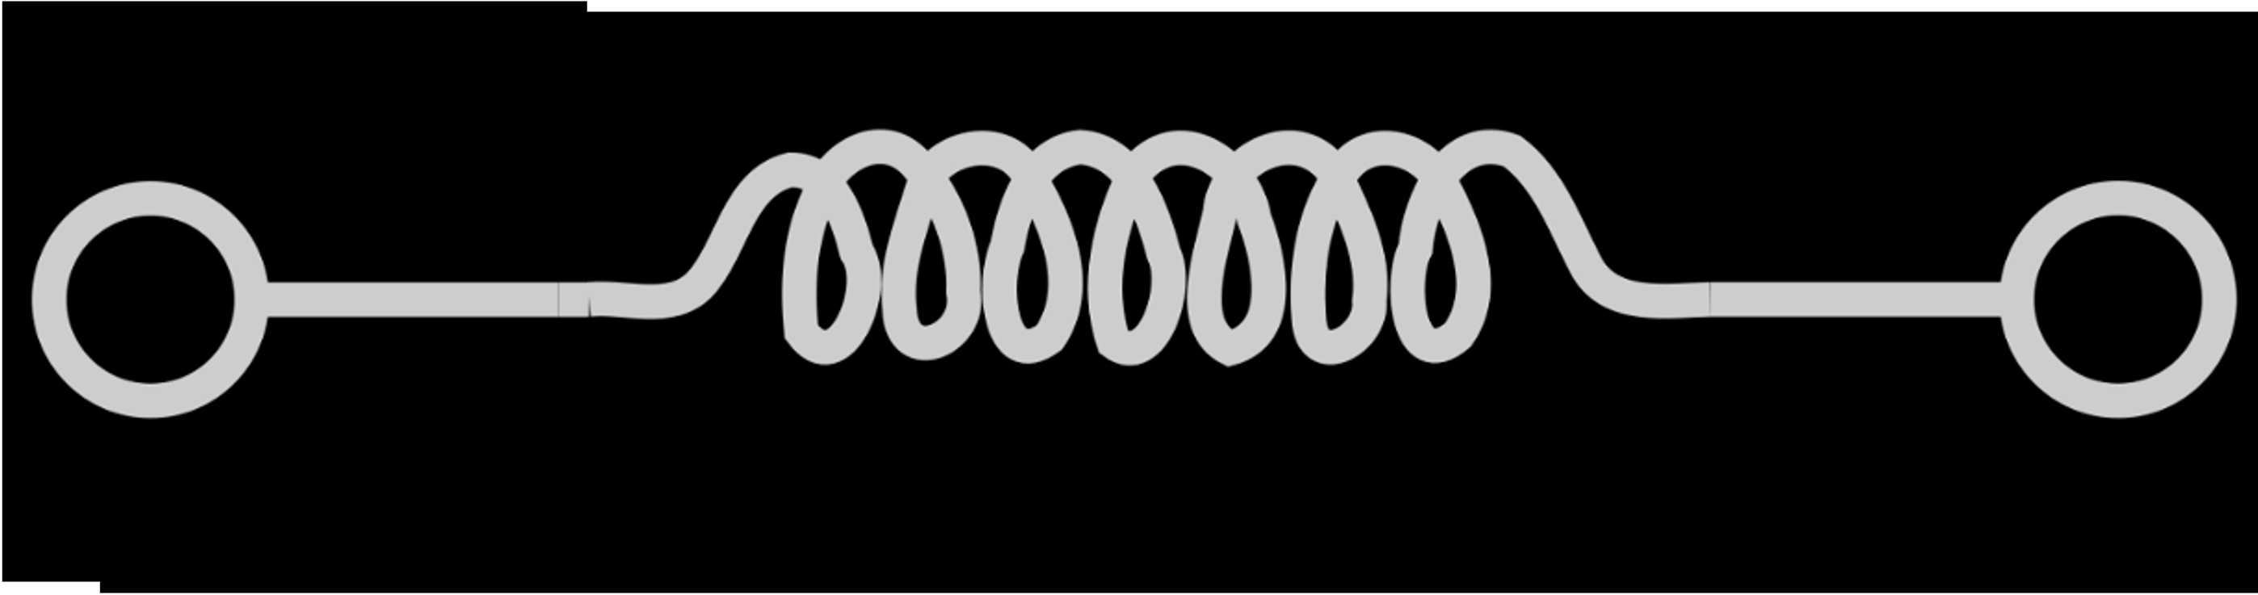

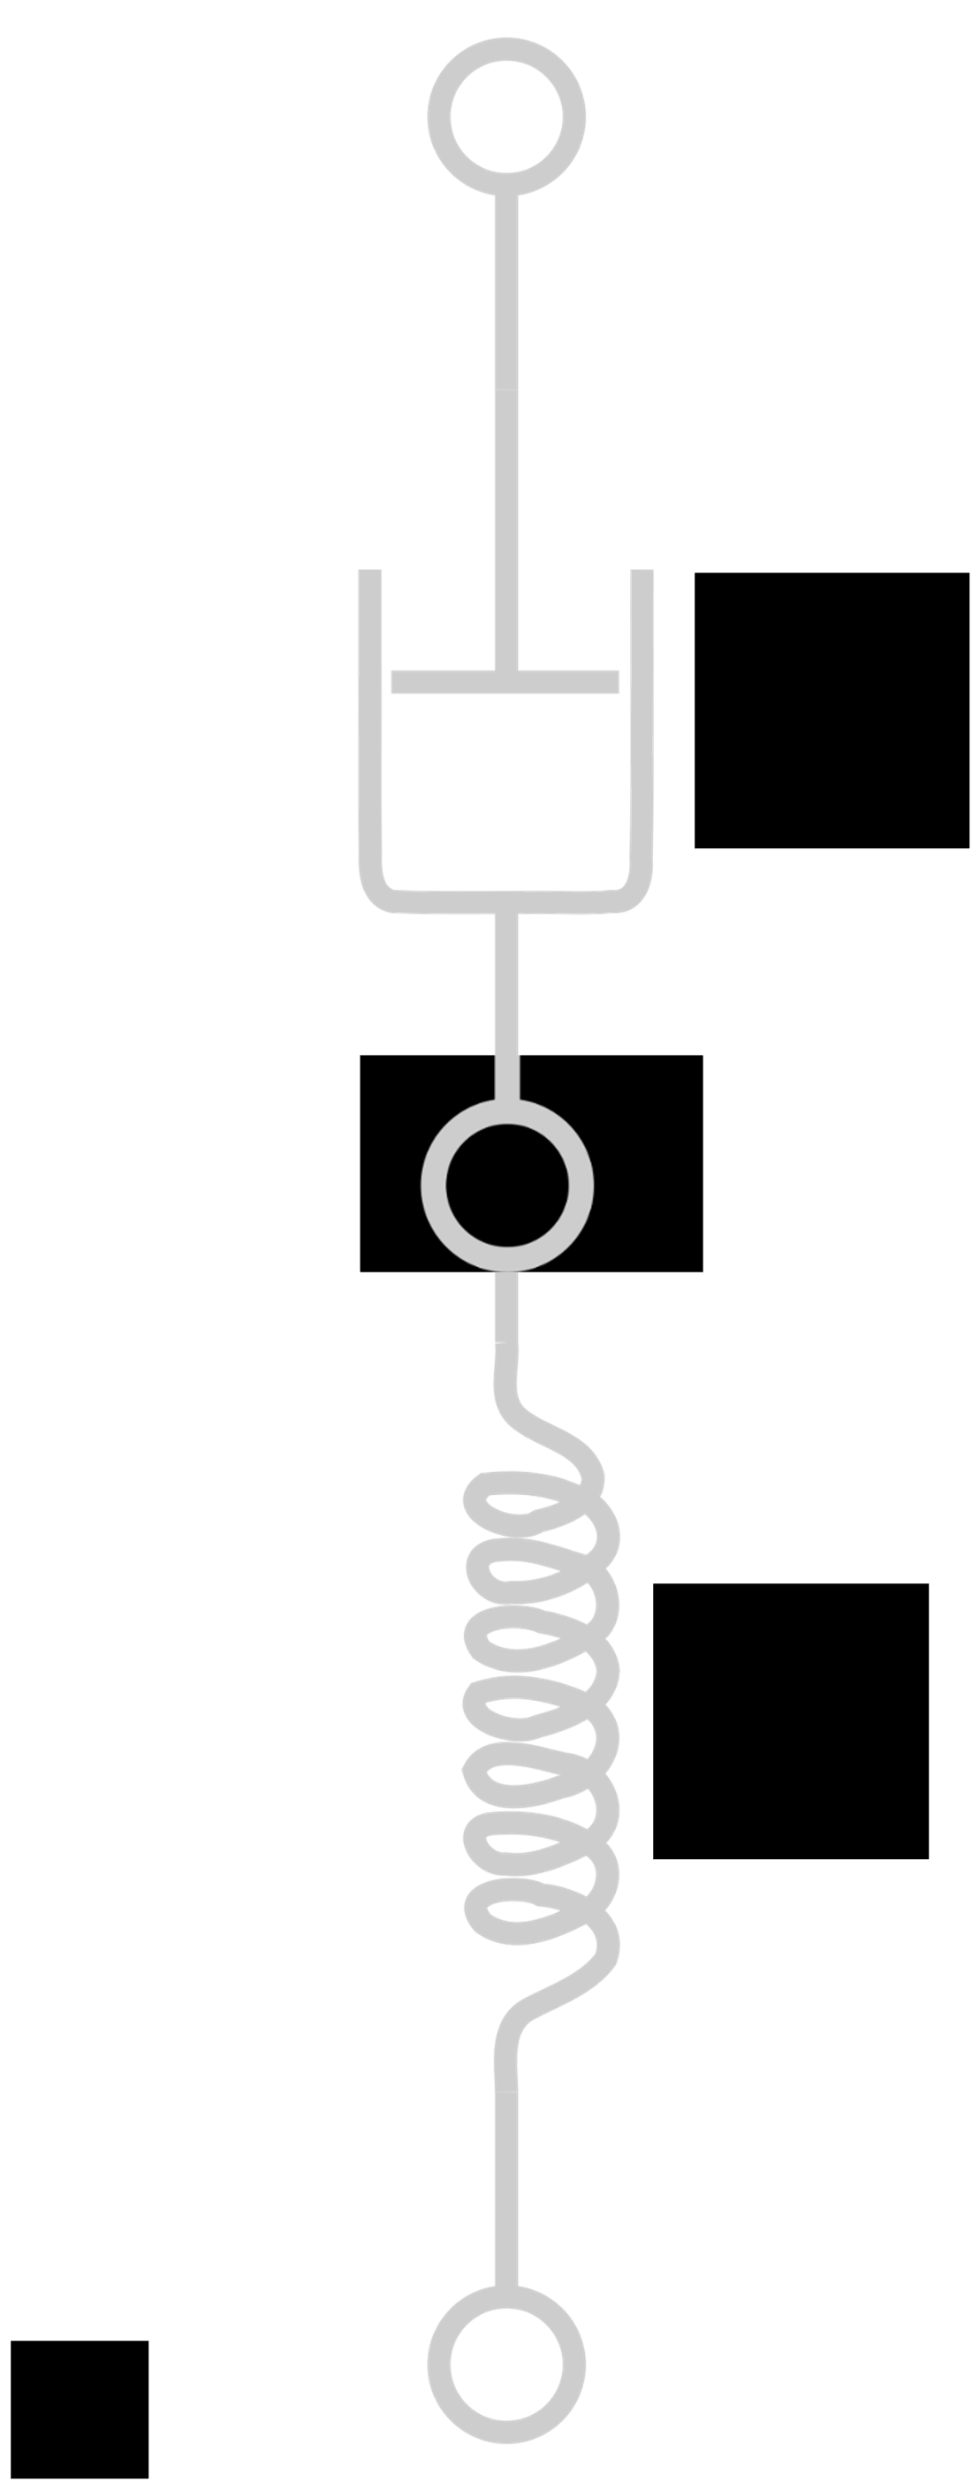


Maxwell linear viscoelastic model
Shear modulus$G_{0}$
Viscosity$μ_{0}$
Maxwell model
Purely elastic spring
Purely viscous damper
Relaxation time
Hooke’s law of elasticity
Newton’s law of viscosity
Relaxation modulus:

Slide 35
Intrinsic material properties of the viscoelastic microdroplet
Relaxation time:
Zero-shear viscosity:
Infinite-frequency modulus:
Deborah number:

Slide 36
Non-dimensionalization scheme

Slide 37
Relevant perturbation expansions
Velocity field and dynamic pressure field expansions:
where
Cauchy stress tensor expansions:

Slide 38
Governing equations in complex space and dimensionless velocity and dynamic pressure fields
Lubrication equations in the complex space:
Dimensionless velocity field:
Dimensionless dynamic pressure field:
where the complex viscosity:

Slide 39
Dimensionless force response
Dimensionless force response:
Perturbation expansion of the force response:
where the static response:
where the dimensionless numbers

Slide 40
Interfacial stress balance

Slide 41
Interfacial stress balance continued…

Slide 42
Kinematic boundary condition and interface shape
Kinematic boundary condition for an interface:
Interface unit normal:
Outer unit normal:
Kinematic condition can be rewritten as:

